Slide 1
Health App – UML Diagrams - Team 4 - R2

Slide 2
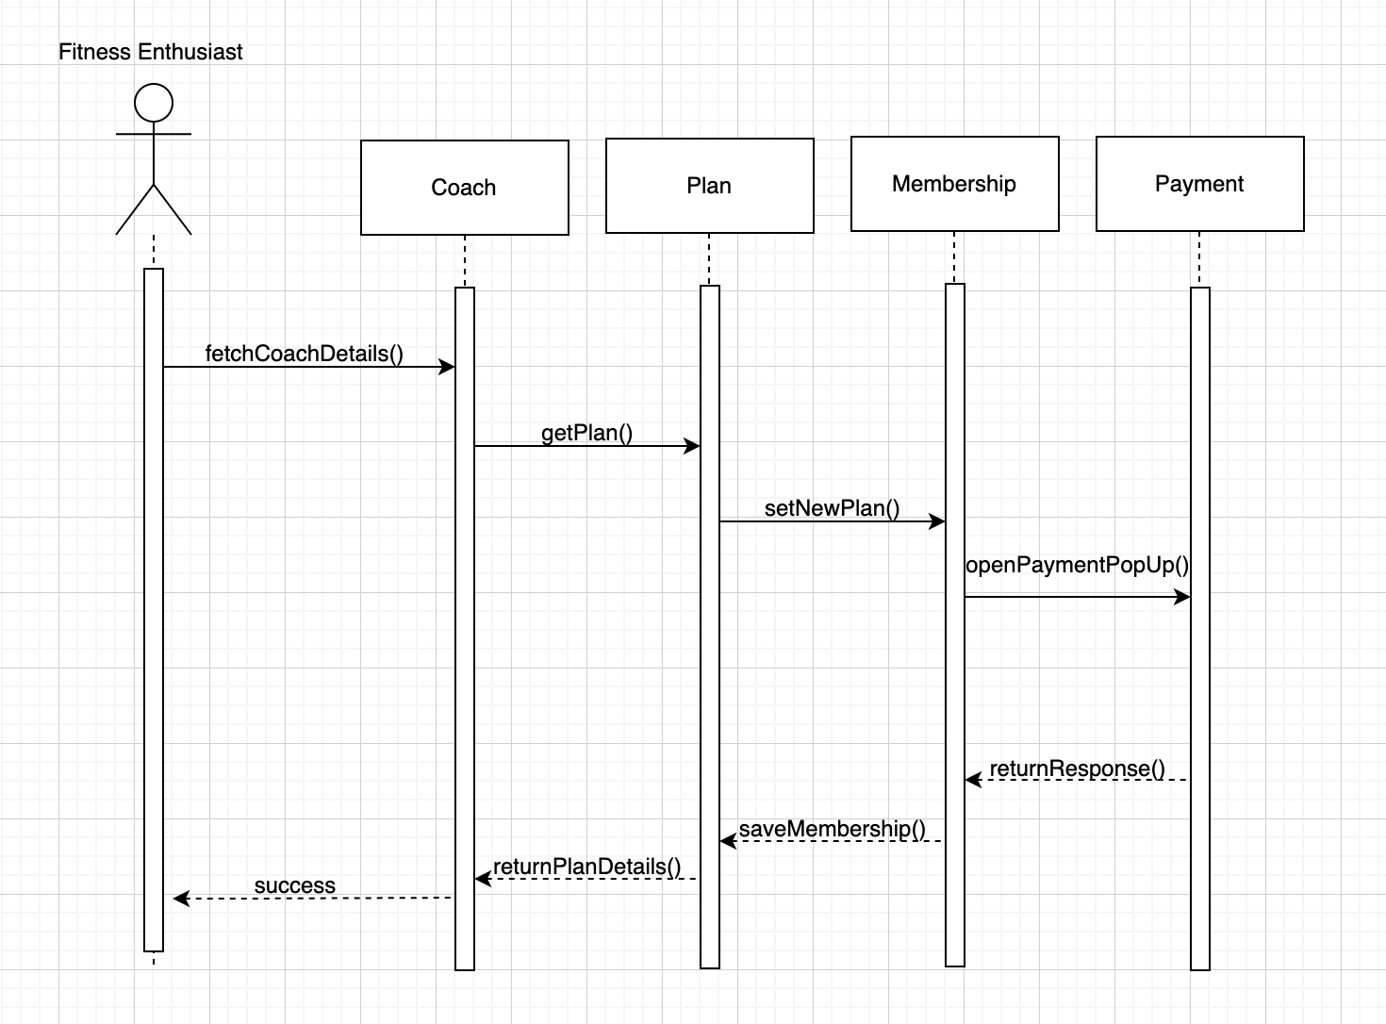
Use Case – 04.02 Subscribe Coach
User Case Outline:
This use case is used to provide fitness enthusiasts with the ability to sign into a Dietitian/Fitness Trainers plan or vice versa; those professionals can have the ability to create or design their own plans to be offered to their clients.
The actor clicks on the "Coaches" tab on the home screen.
The system opens the "Coaches" screen where the list of registered coaches is displayed.
The actor scrolls through the list to view the coaches they are interested in.
The actor selects a coach to view their profile.
The system opens the profile of the selected coach, and the fitness enthusiast can view details about the coach's credentials, specialties, and reviews.
The actor can subscribe to the coach plans.
The System opens a pop-up, and the user can do the payment process with the price that the coach specifies on the plans.
The System responds with a confirmation message.
The system saves the payment details and sends the payment to the credit card vendor for approval.
The actor now has all the access in the plans and can start using it.

Slide 3
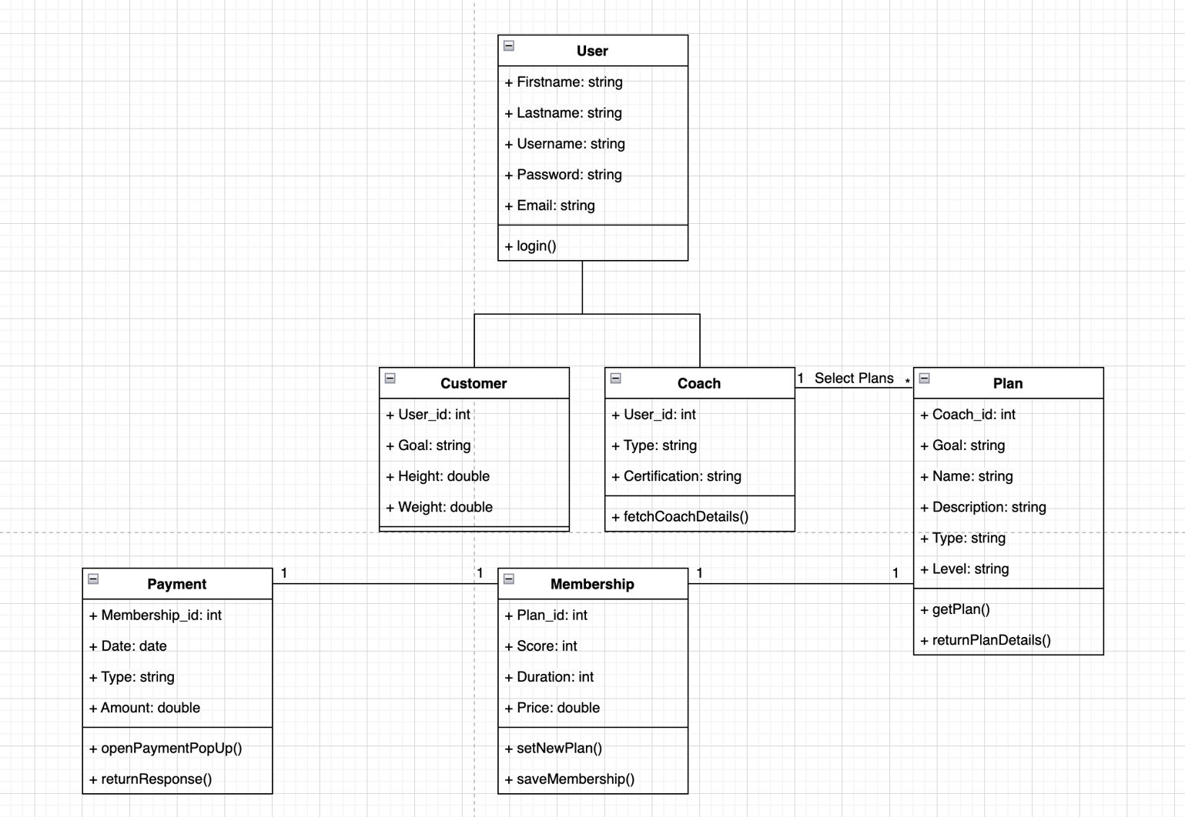
Use Case – 04.02 Subscribe Coach

Slide 4
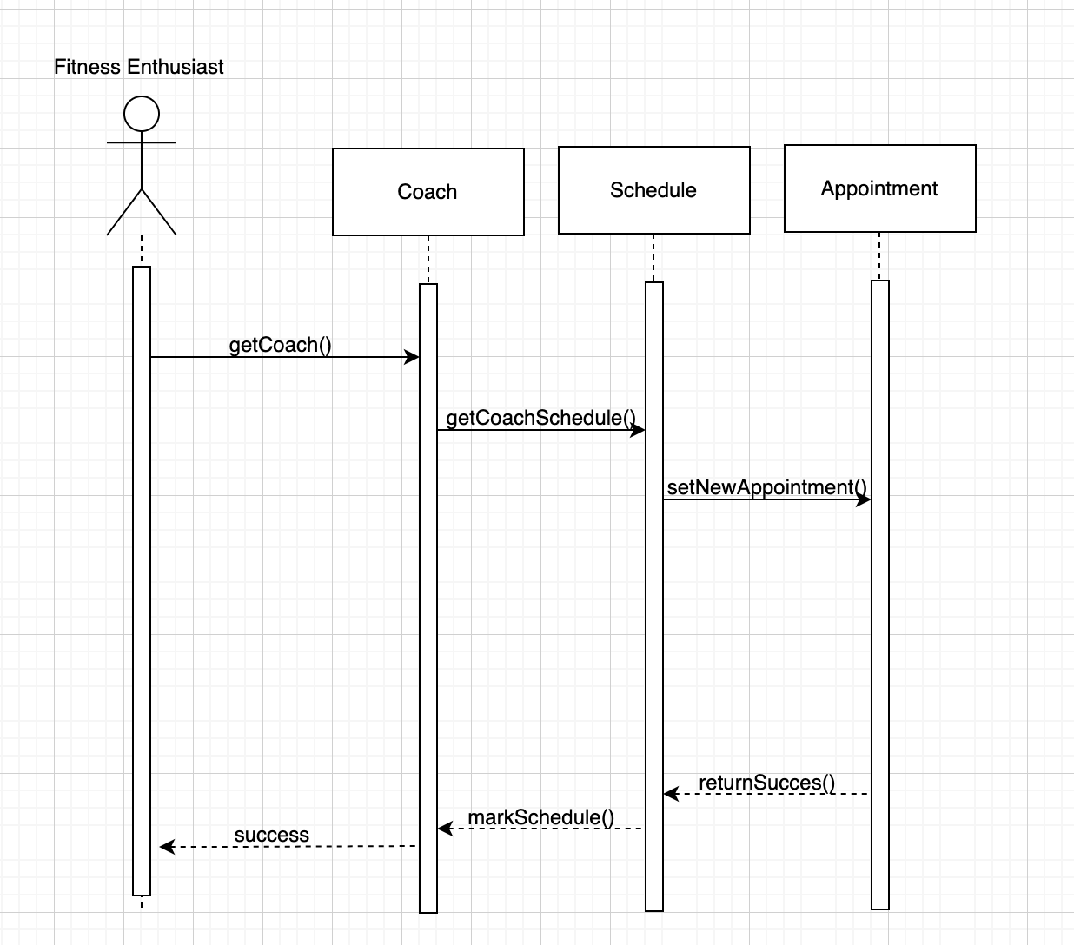
Use Case – 04.03 Schedule Appointment
User Case Outline:
This use case Actor can schedule appointments based on the availability of dietitians and fitness Actors are able to request to reschedule appointments as needed.
The Actor selects the option to schedule an appointment with a preferred fitness or dietitian Trainer.
The system opens the "Appointments" screen where the Actor can view the availability of the designated Trainer.
The Actor select a suitable date and time for the appointment and confirm the booking.
The system sends a confirmation message to the user, displaying the appointment details, including the date, time, and location of the appointment.
If the Actor need to reschedule the appointment, they can go to the "Appointments" screen and select the appointment they want to change.
The system displays the details of the selected appointment and offers alternative dates and times.

Slide 5
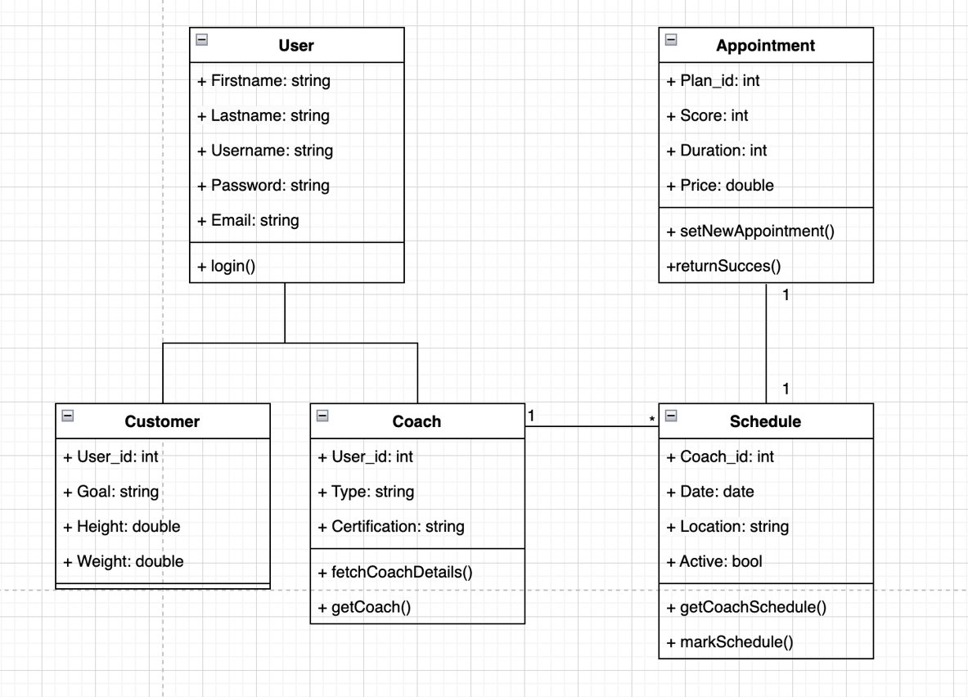
Use Case – 04.03 Schedule Appointment

Slide 6
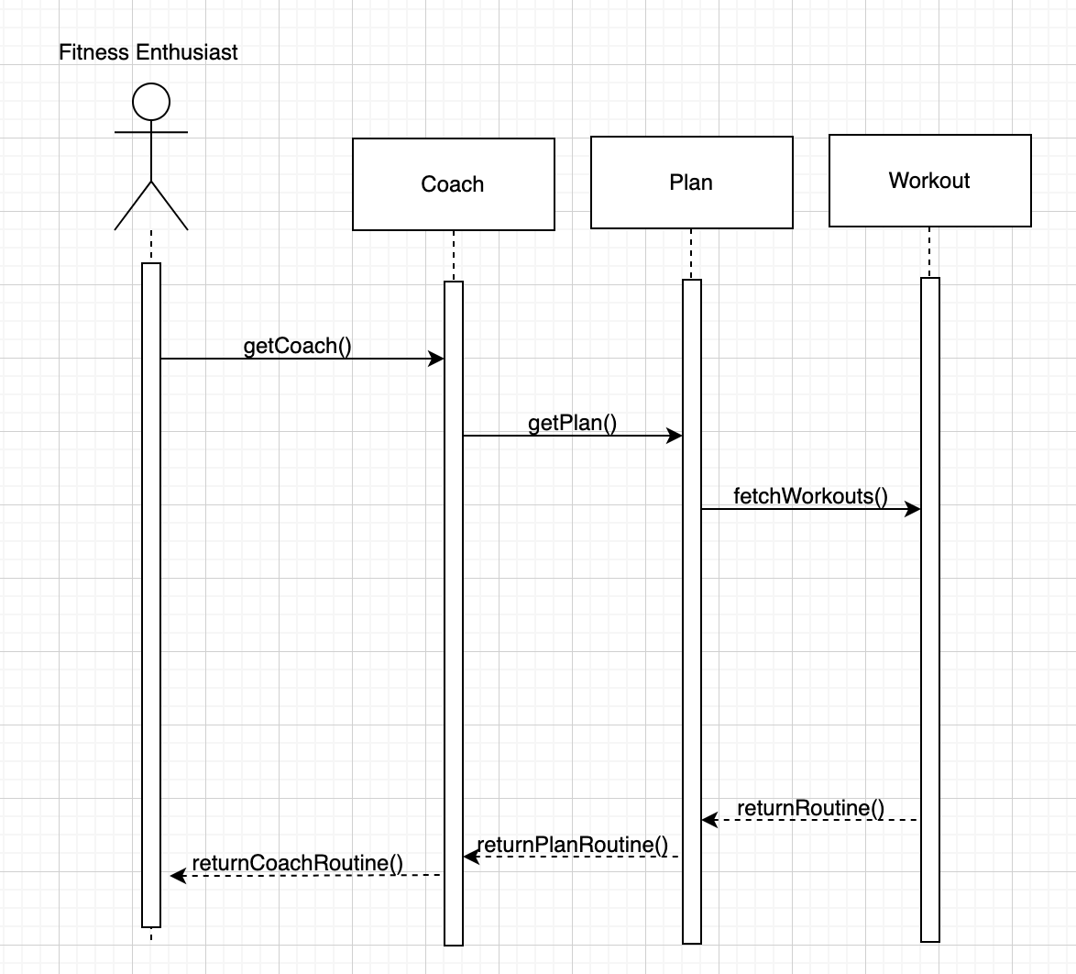
Use Case – 04.04 Access Routine
User Case Outline:
This use case Fitness Enthusiasts can access routine designed for them by dietitians/fitness trainers.
Actor logs in to their account and clicks on ‘Coach’ button.
The system displays the image, name, and description of the subscribed coach on screen.
Actors click on the ‘Access Routine’ button to access their routine designed for actor which is available in database.
System displays the routine designed specifically for the actor from the database, which include ‘Exercise Routine’, ‘Nutrition Plan’ and other relevant information.
Actor can message for feedback and support required from their chosen dietitian/ fitness trainer from the same screen by entering text input and clicking on ‘Contact coach’ button.
System shows ‘Feedback submitted successfully message.

Slide 7
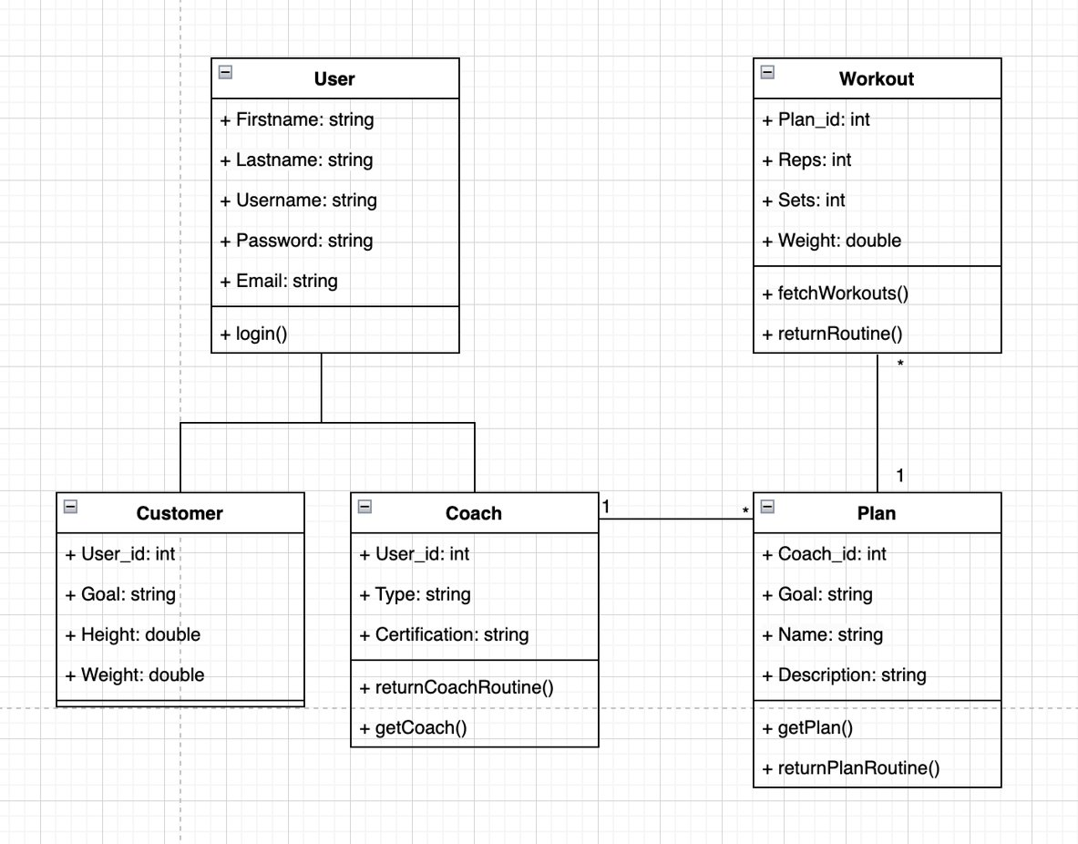
Use Case – 04.04 Access Routine

Slide 8
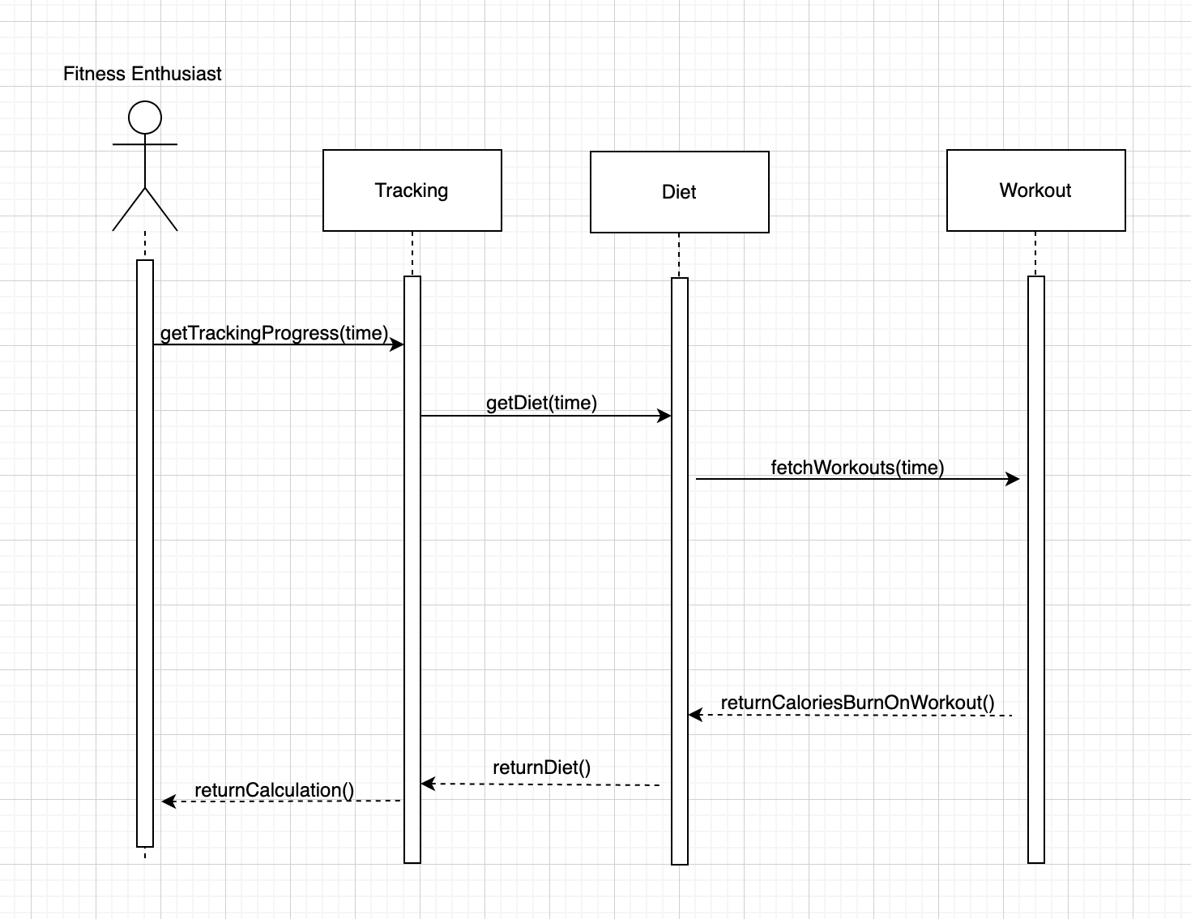
Use Case – 05.01 Display Fitness Activity Sequence Diagram
User Case Outline:
In this use case Actors can track their daily/weekly/monthly fitness activities.
System redirects the actor to the dashboard and shows the display fitness activity button.
Actor clicks on ‘Display Fitness Activity’ button.
System navigates to the page where actors can view their fitness activity based on selected period.
Actor can view step counts, data of which system accesses from external applications.
If the actor is a new user and clicks on ‘Display Fitness Activity’ button, the system responds with a message which actor can see on screen.

Slide 9
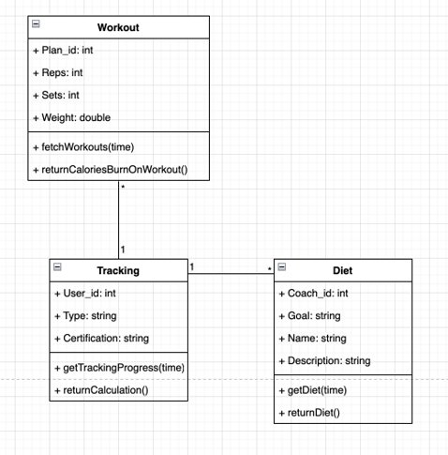
Use Case – 05.01 Display Fitness Activity Class Diagram

Slide 10
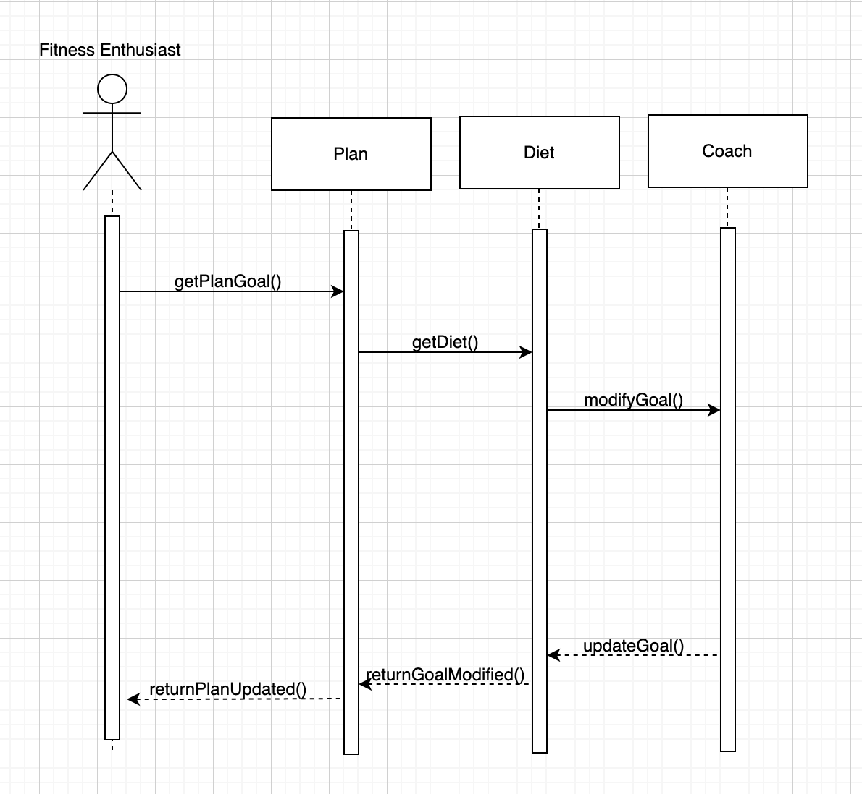
Use Case – 05.03 List User Goals Sequence Diagram
User Case Outline:
In this use case Actors can see and list their diets and view and list their fitness daily/weekly/monthly goal and share the same with the fitness trainers for consultation and making a more informed decision.
The actor navigates to the list of Goal section of Health App and clicks on ‘List User Goals’ button.
The system opens the "Diet plan list " screen where the Actor can view the diet plan list with list of goals.
The actor selects a suitable diet plan according to user goals and the system saves the same user goals in database.
The system sends a confirmation message to the user, displaying the diet plan with their goal in detail.
If the Actor needs to change user goal, then they can go to the "List user goal" screen and select the user goal they want to change.
The system displays the details of the user goal.
If the Actor confirms a goal, the system updates the actor’s goal accordingly and sends a confirmation message to the Actor.

Slide 11
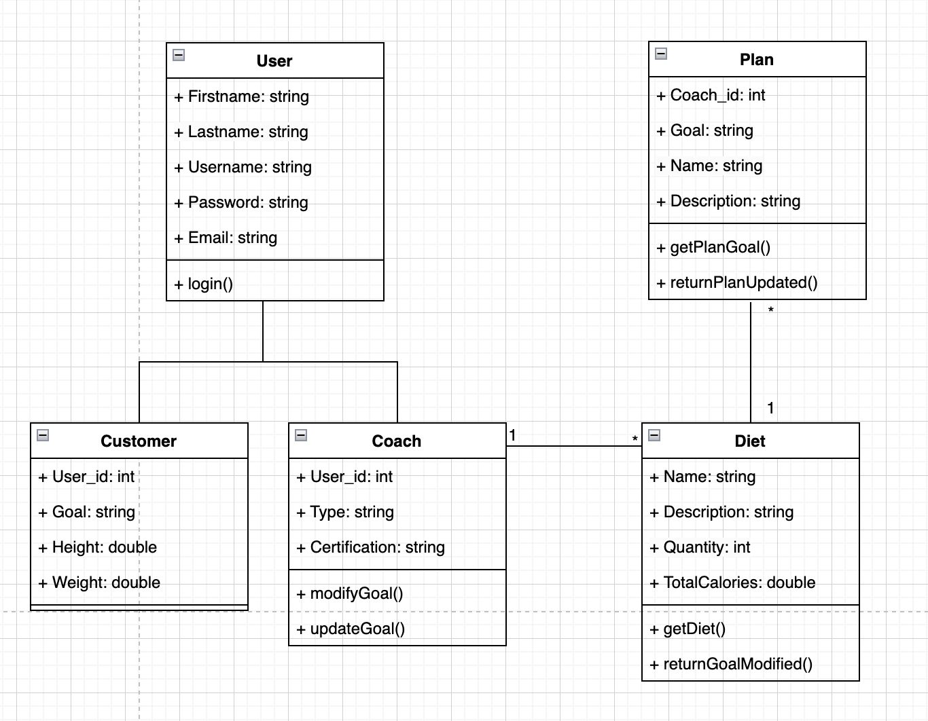
Use Case – 05.03 List User Goals

